Slide 1
Study Design in Epidemiology and Ecology
E²M²: Ecological and Epidemiological Modeling in Madagascar
Centre ValBio
Ranomafana National Park, Madagascar
December 2022

Slide 2

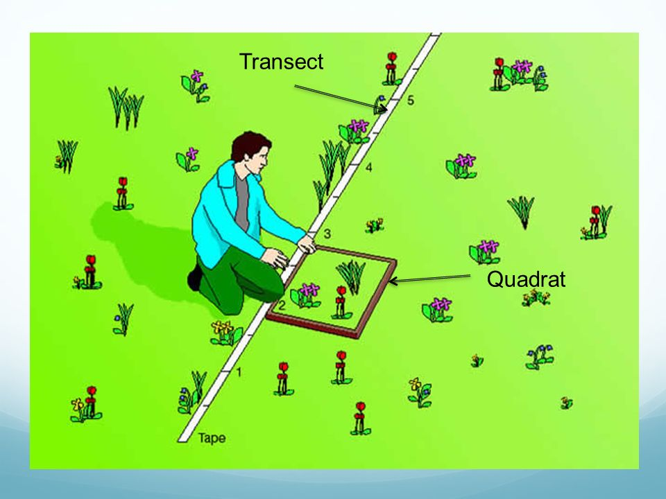
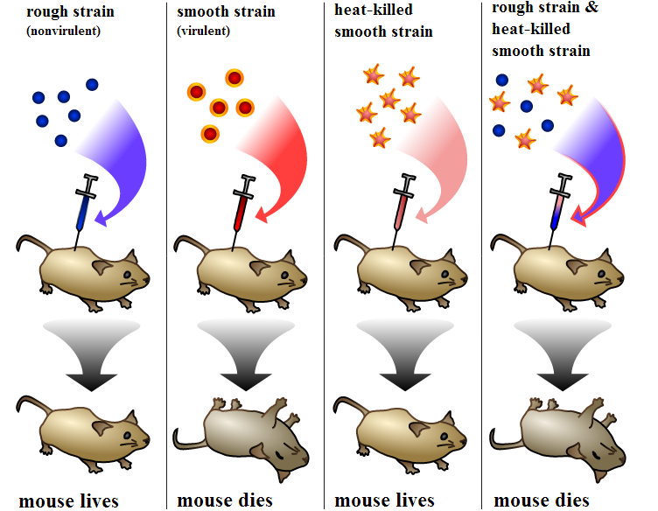
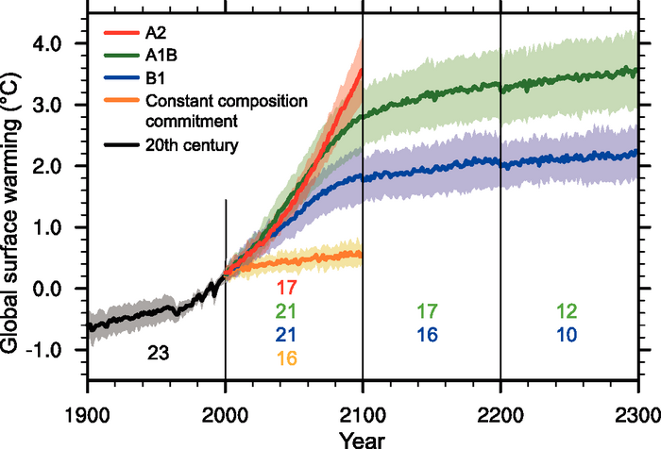
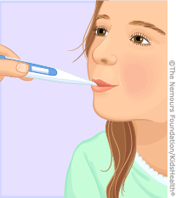
Data: Sources of x and y
Observational | Experimental | Simulated
- Just measure x and y | - Interfere with x or the relationship between x and y | - Create a relationship between x and y
Observational | Experimental | Simulated
- Just measure x and y | - Interfere with x or the relationship between x and y | - Create a relationship between x and y
Empirical data

Slide 3
Data: Sources of x and y
Observational | Experimental | Simulated
- Just measure x and y | - Interfere with x or the relationship between x and y | - Create a relationship between x and y
Observational | Experimental | Simulated
- Just measure x and y | - Interfere with x or the relationship between x and y | - Create a relationship between x and y
How do we choose the best method of data collection?
Empirical data

Slide 4
Data: Sources of x and y
Observational | Experimental | Simulated
- Just measure x and y | - Interfere with x or the relationship between x and y | - Create a relationship between x and y
Observational | Experimental | Simulated
- Just measure x and y | - Interfere with x or the relationship between x and y | - Create a relationship between x and y
How do we choose the best method of data collection?
The ‘best method’ will depend on the question!
Empirical data

Slide 5
Model-Guided Field Work

Slide 6
Model-Guided Field Work
a rational dialogue between researchers from multiple disciplines through a series of iterative steps, ultimately leading to improved causal inference and predictive power.

Slide 7
Model-Guided Field Work
a rational dialogue between researchers from multiple disciplines through a series of iterative steps, ultimately leading to improved causal inference and predictive power.
biologists and modellers collaborate at all stages of the study, from initial model formulation and field study design, to data collection and analysis.

Slide 8
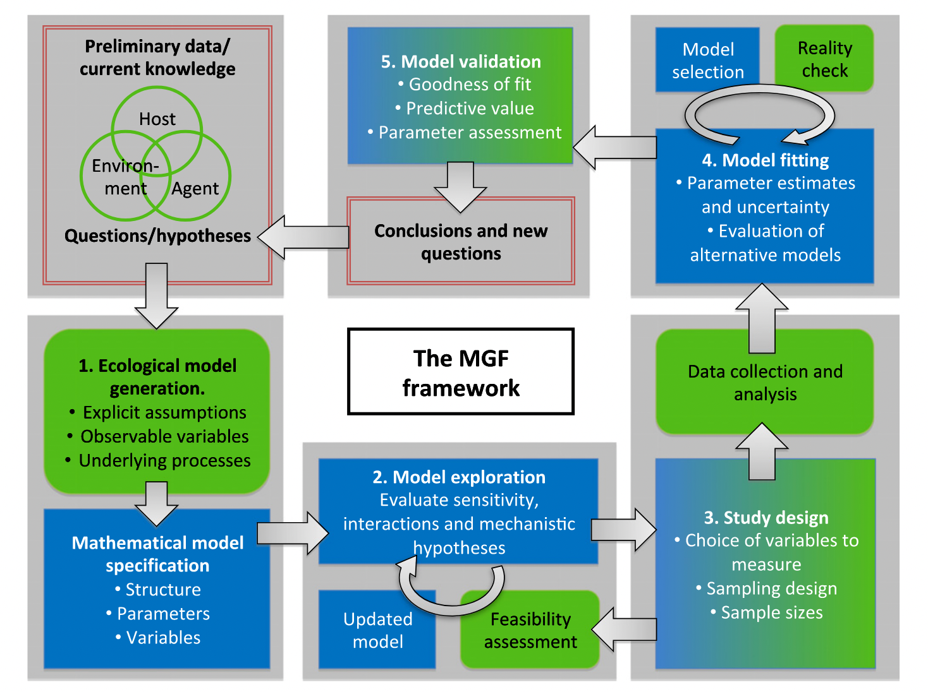
Model-Guided Field Work
Restif et al. 2012 Ecology Letters

Slide 9
Model-Guided Field Work
Restif et al. 2012 Ecology Letters

Slide 10
Model-Guided Field Work
Formulating research questions
Restif et al. 2012 Ecology Letters

Slide 11
Model-Guided Field Work
Formulating research questions
Model diagram
Restif et al. 2012 Ecology Letters

Slide 12
Model-Guided Field Work
Formulating research questions
Model diagram
Model simulation
Restif et al. 2012 Ecology Letters

Slide 13
Model-Guided Field Work
Formulating research questions
Model diagram
Study design
Model simulation
Restif et al. 2012 Ecology Letters

Slide 14
Model-Guided Field Work
Formulating research questions
Data collection
Model diagram
Study design
Model simulation
Restif et al. 2012 Ecology Letters

Slide 15
Model-Guided Field Work
Model fitting
Formulating research questions
Data collection
Model diagram
Study design
Model simulation
Restif et al. 2012 Ecology Letters

Slide 16
Model-Guided Field Work
Model evaluation
Model fitting
Formulating research questions
Data collection
Model diagram
Study design
Model simulation
Restif et al. 2012 Ecology Letters

Slide 17
Model-Guided Field Work
a rational dialogue between researchers from multiple disciplines through a series of iterative steps, ultimately leading to improved causal inference and predictive power.
biologists and modellers collaborate at all stages of the study, from initial model formulation and field study design, to data collection and analysis.
applicable in both ecology AND epidemiology!

Slide 18
Epidemiological Study Design
Target Population
Target: Population to which it might be possible to extrapolate results of the study

Slide 19
Epidemiological Study Design
Target Population
Target: Population to which it might be possible to extrapolate results of the study
Source Population
Source: Population from which study participants are drawn

Slide 20
Epidemiological Study Design
Target Population
Target: Population to which it might be possible to extrapolate results of the study
Source Population
Source: Population from which study participants are drawn
Study Population
Study: Actual sampled population

Slide 21
Epidemiological Study Design
Target Population
Target: Population to which it might be possible to extrapolate results of the study
Source Population
Source: Population from which study participants are drawn
Study Population
Study: Actual sampled population
Well-designed studies allow us to make inferences about the target population

Slide 22
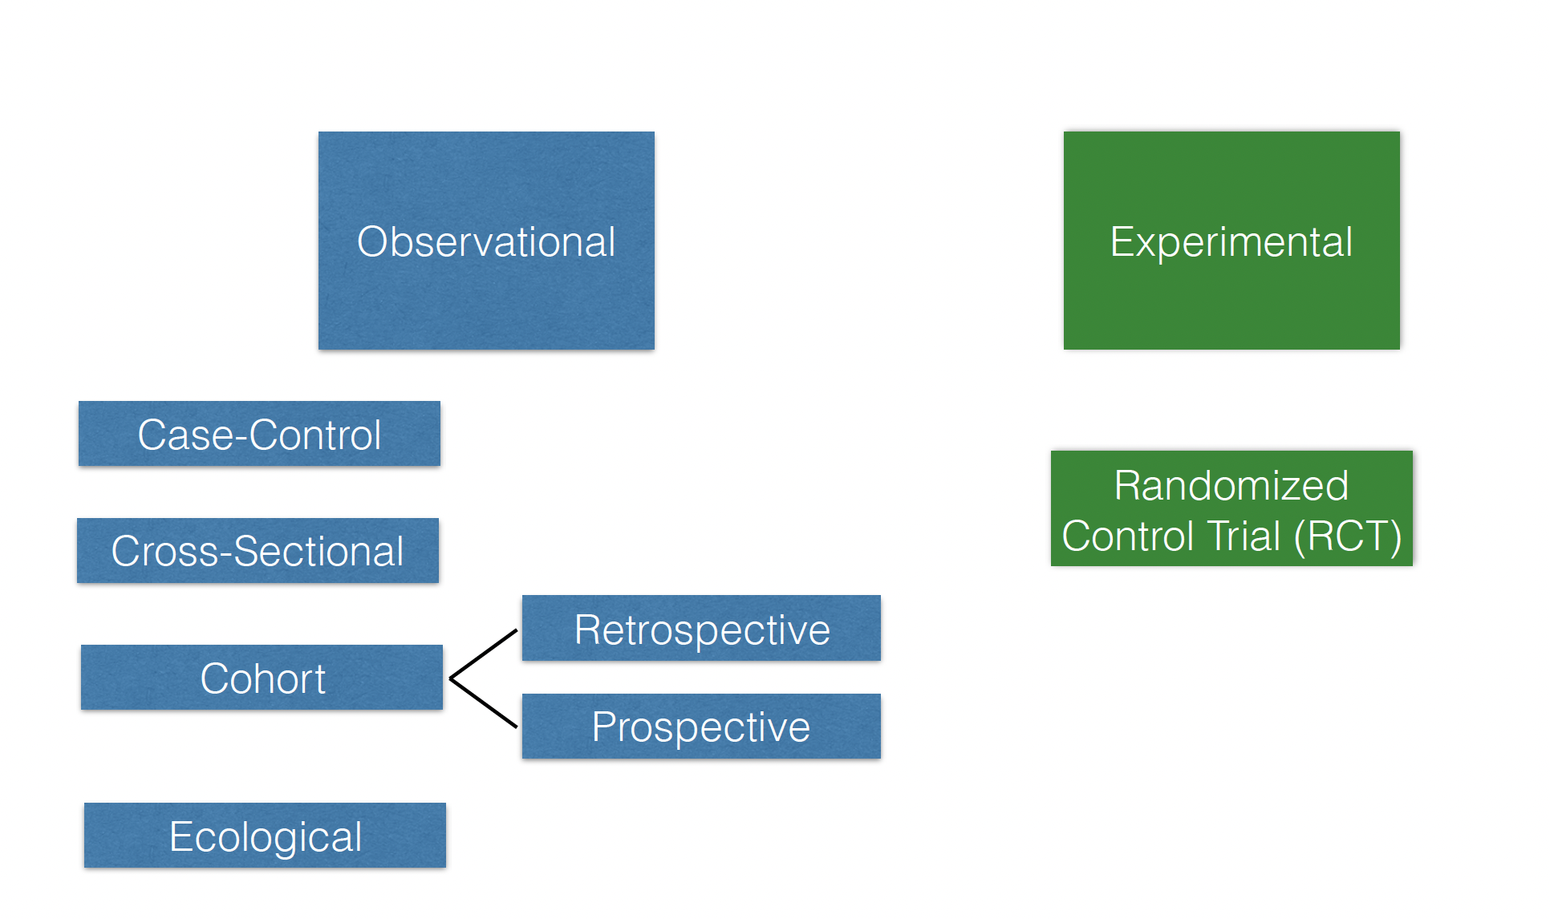
Different Study Types in Epidemiology

Slide 23
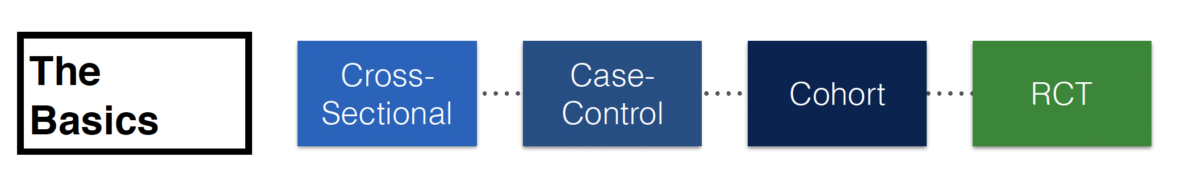

Slide 24
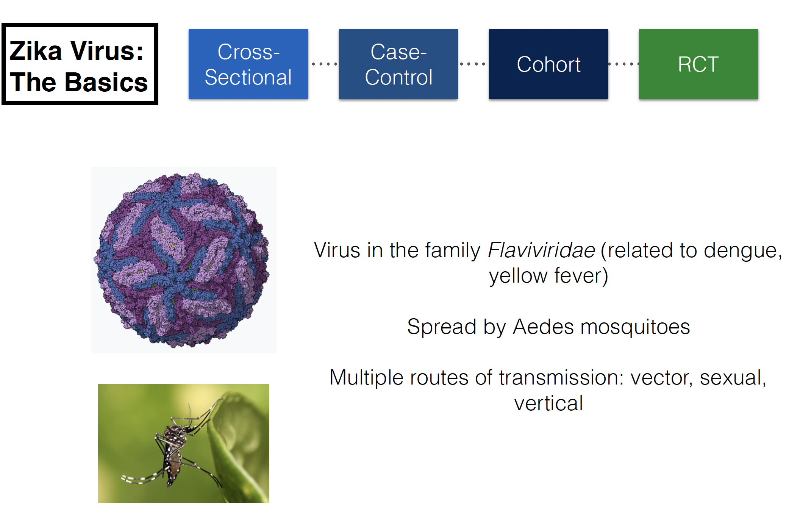

Slide 25
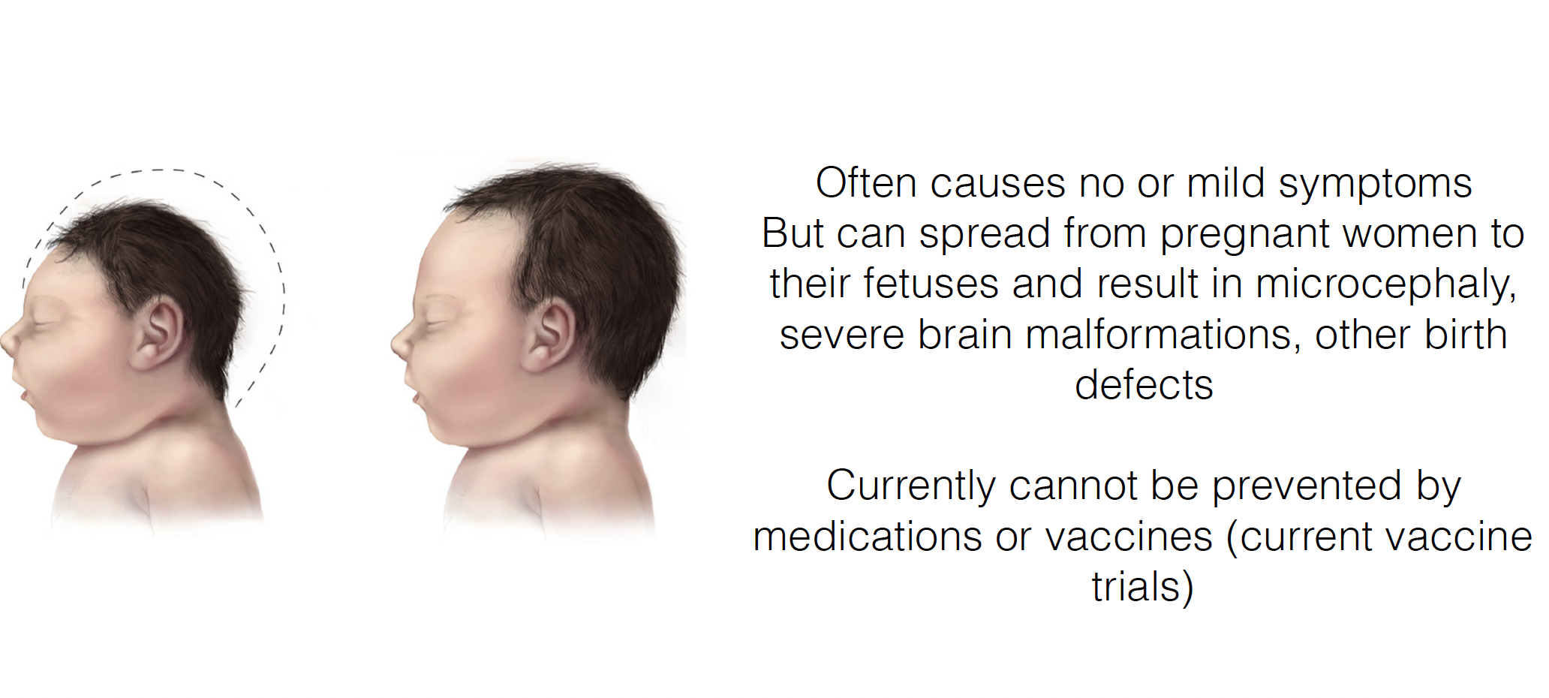

Slide 26
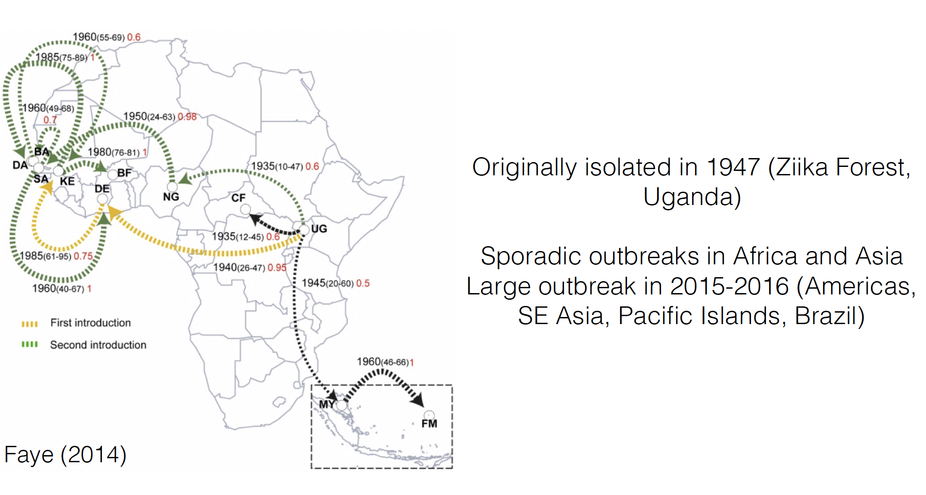

Slide 27
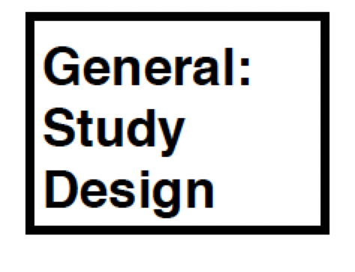
Cross-Sectional Study
Examines relationship between diseases and other variables of interest (e.g. geographic distribution)
Presence/absence of disease is determined for all members of a population
Commonly used to estimate prevalence (rather than incidence)
A single snapshot of the population at a moment in time
Exposure and outcome are assessed simultaneously

Slide 28
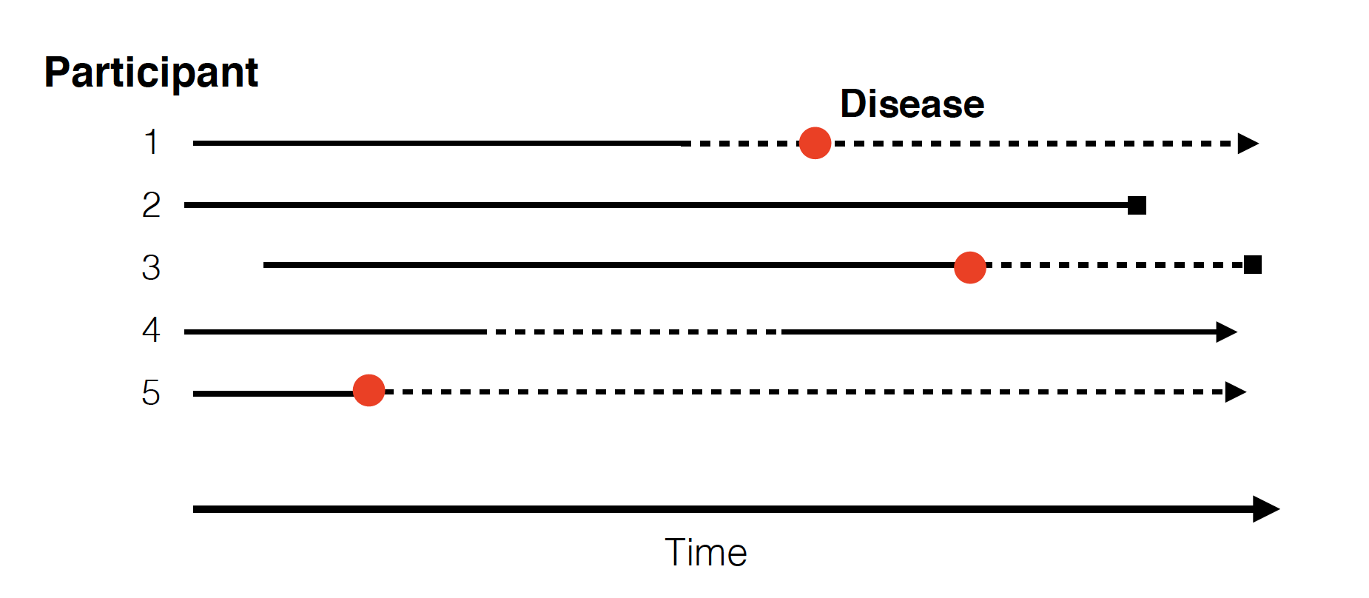
Cross-Sectional Study

Slide 29
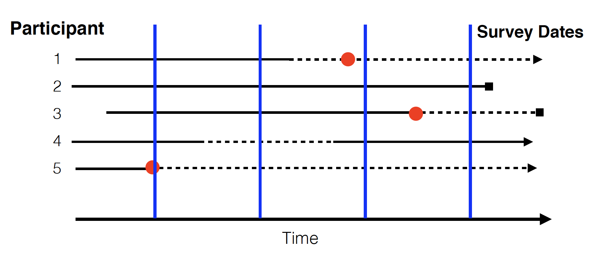
Cross-Sectional Study

Slide 30
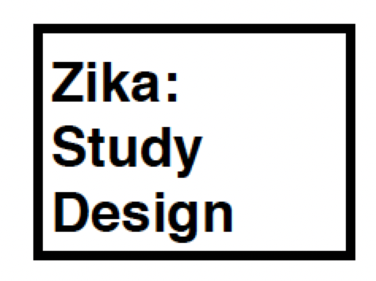
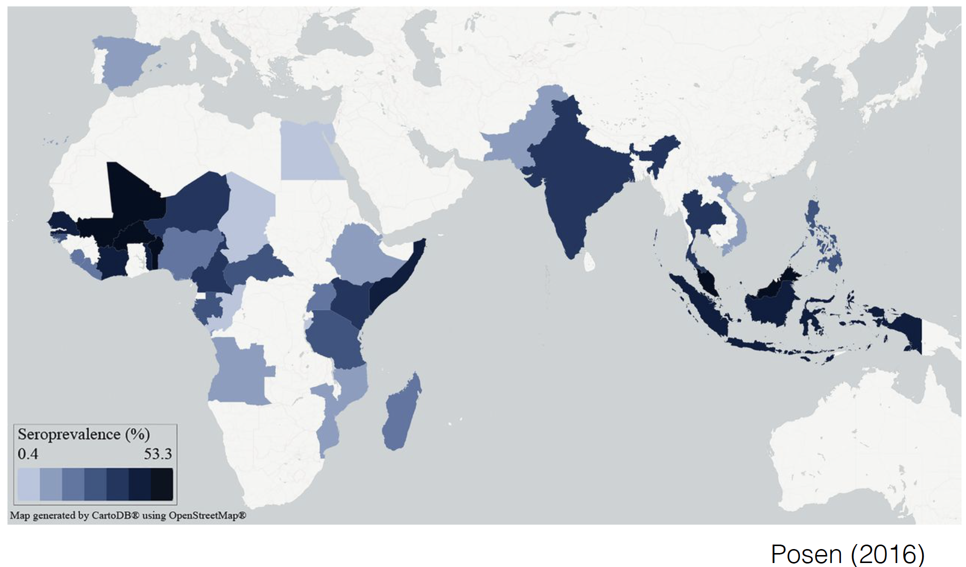
Cross-Sectional Study

Slide 31
Case Control Study
The observational epidemiological study of persons with a disease of interest and a suitable control group of persons without the disease
Potential relationship of a suspected risk factor or an attribute to the disease is examined by comparing the the disease and non-diseased subjects with regard to how frequently the factor or attribute is present in each of these groups.

Slide 32
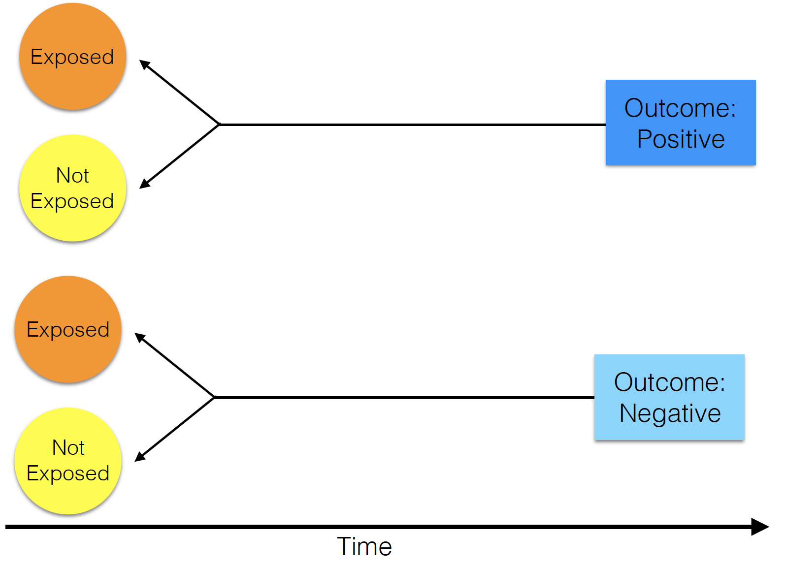
Case Control Study

Slide 33
Case Control Study
What is the relationship between maternal Zika infection and microcephaly?

Slide 34
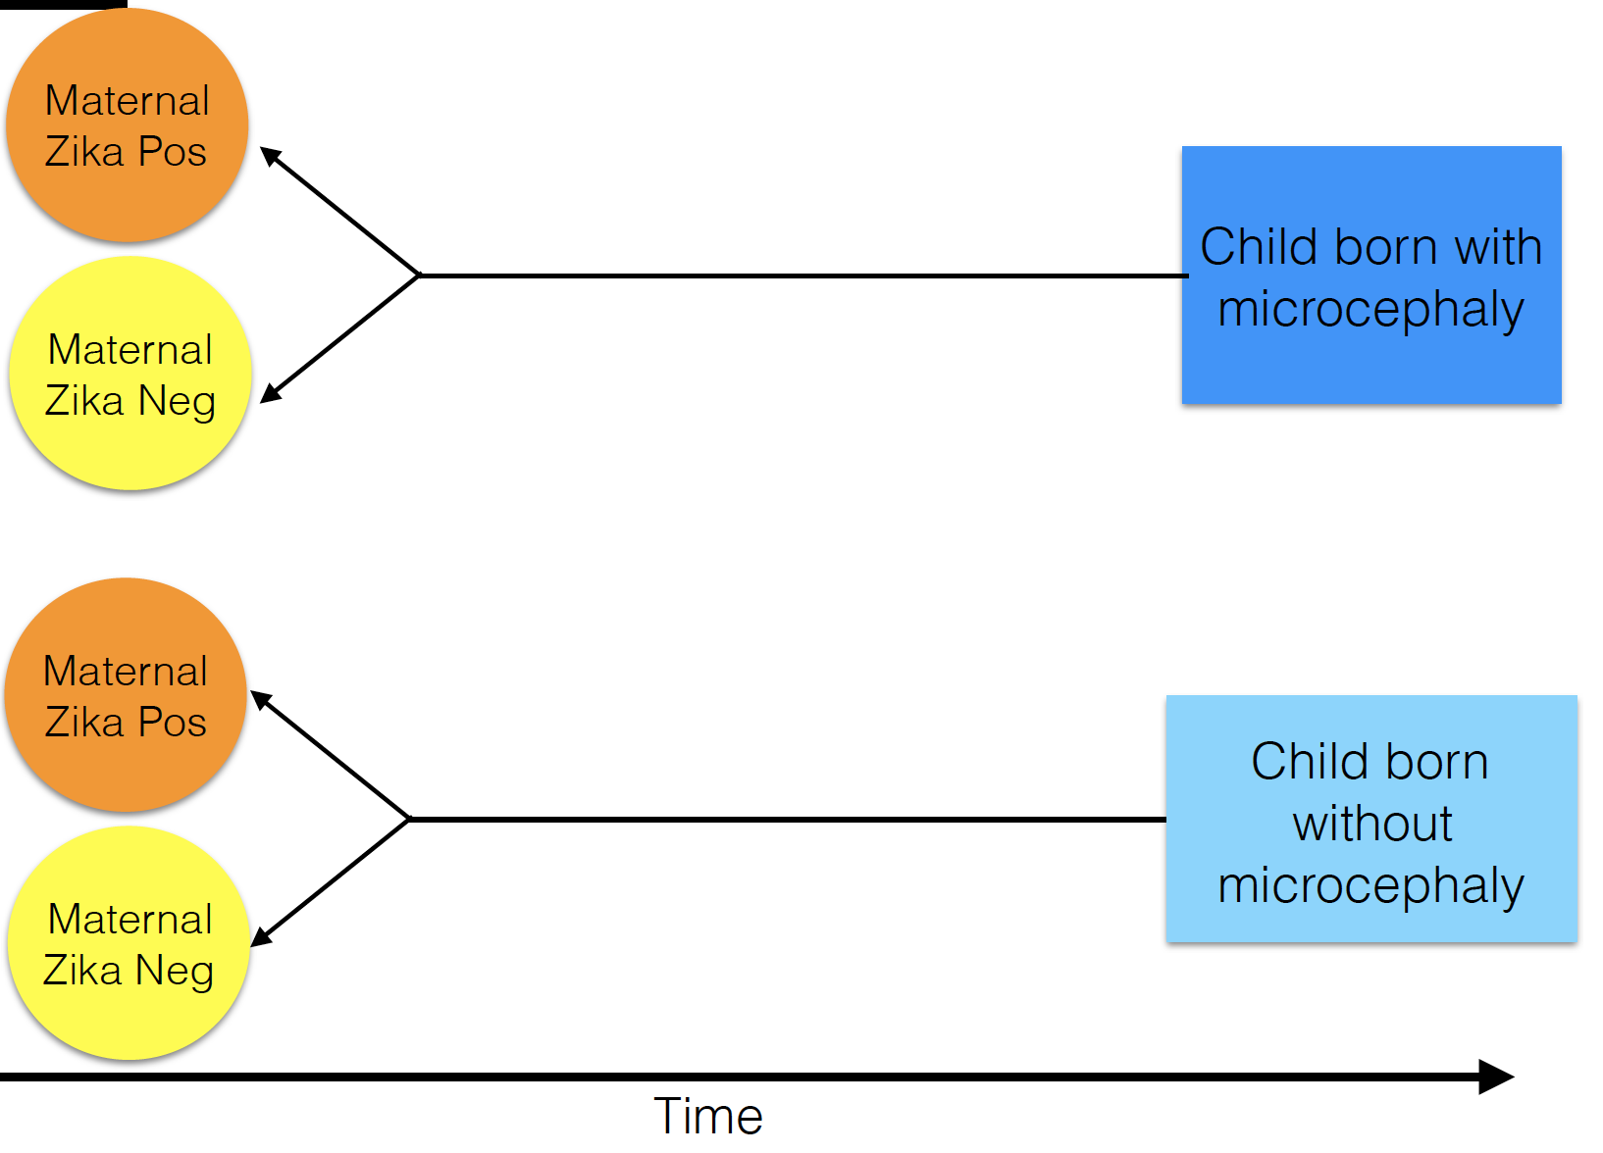
Case Control Study

Slide 35
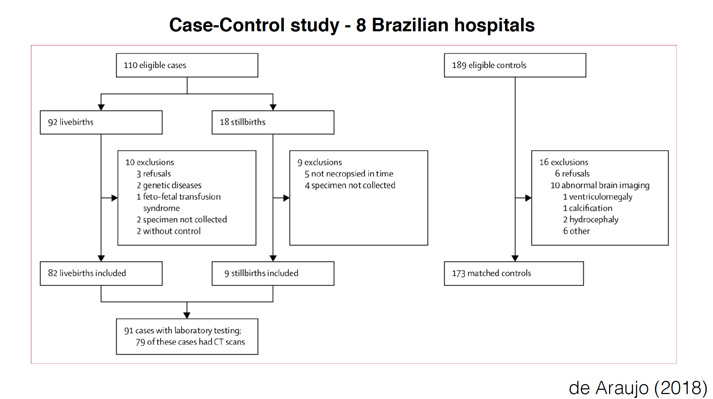
Case Control Study

Slide 36
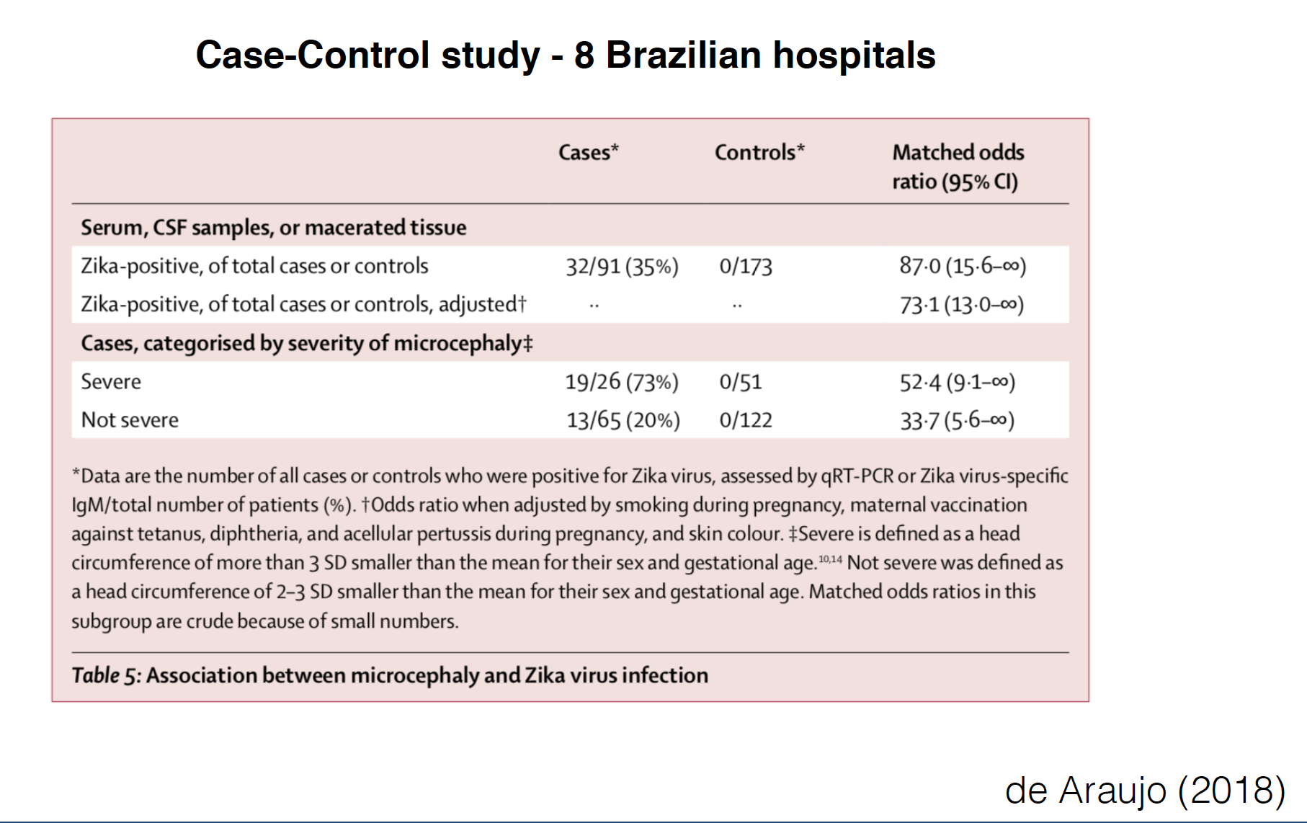

Slide 37
Cohort Study
Enrolled group of people who have a common experience or grouping.
Age cohort, risk cohort
General population sample
Clinic based
Prospective or retrospective

Slide 38
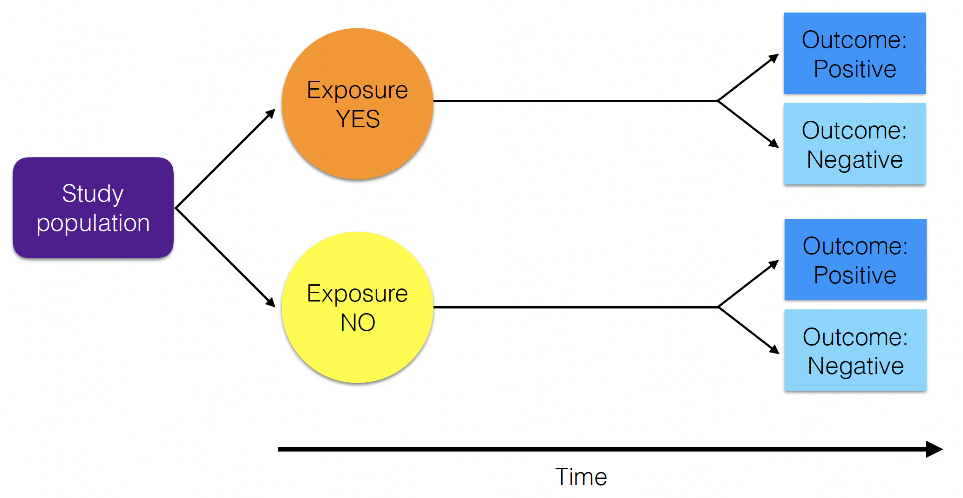
Cohort Study

Slide 39
Cohort Study
What is the rate of maternal-fetal transmission of Zika virus?

Slide 40
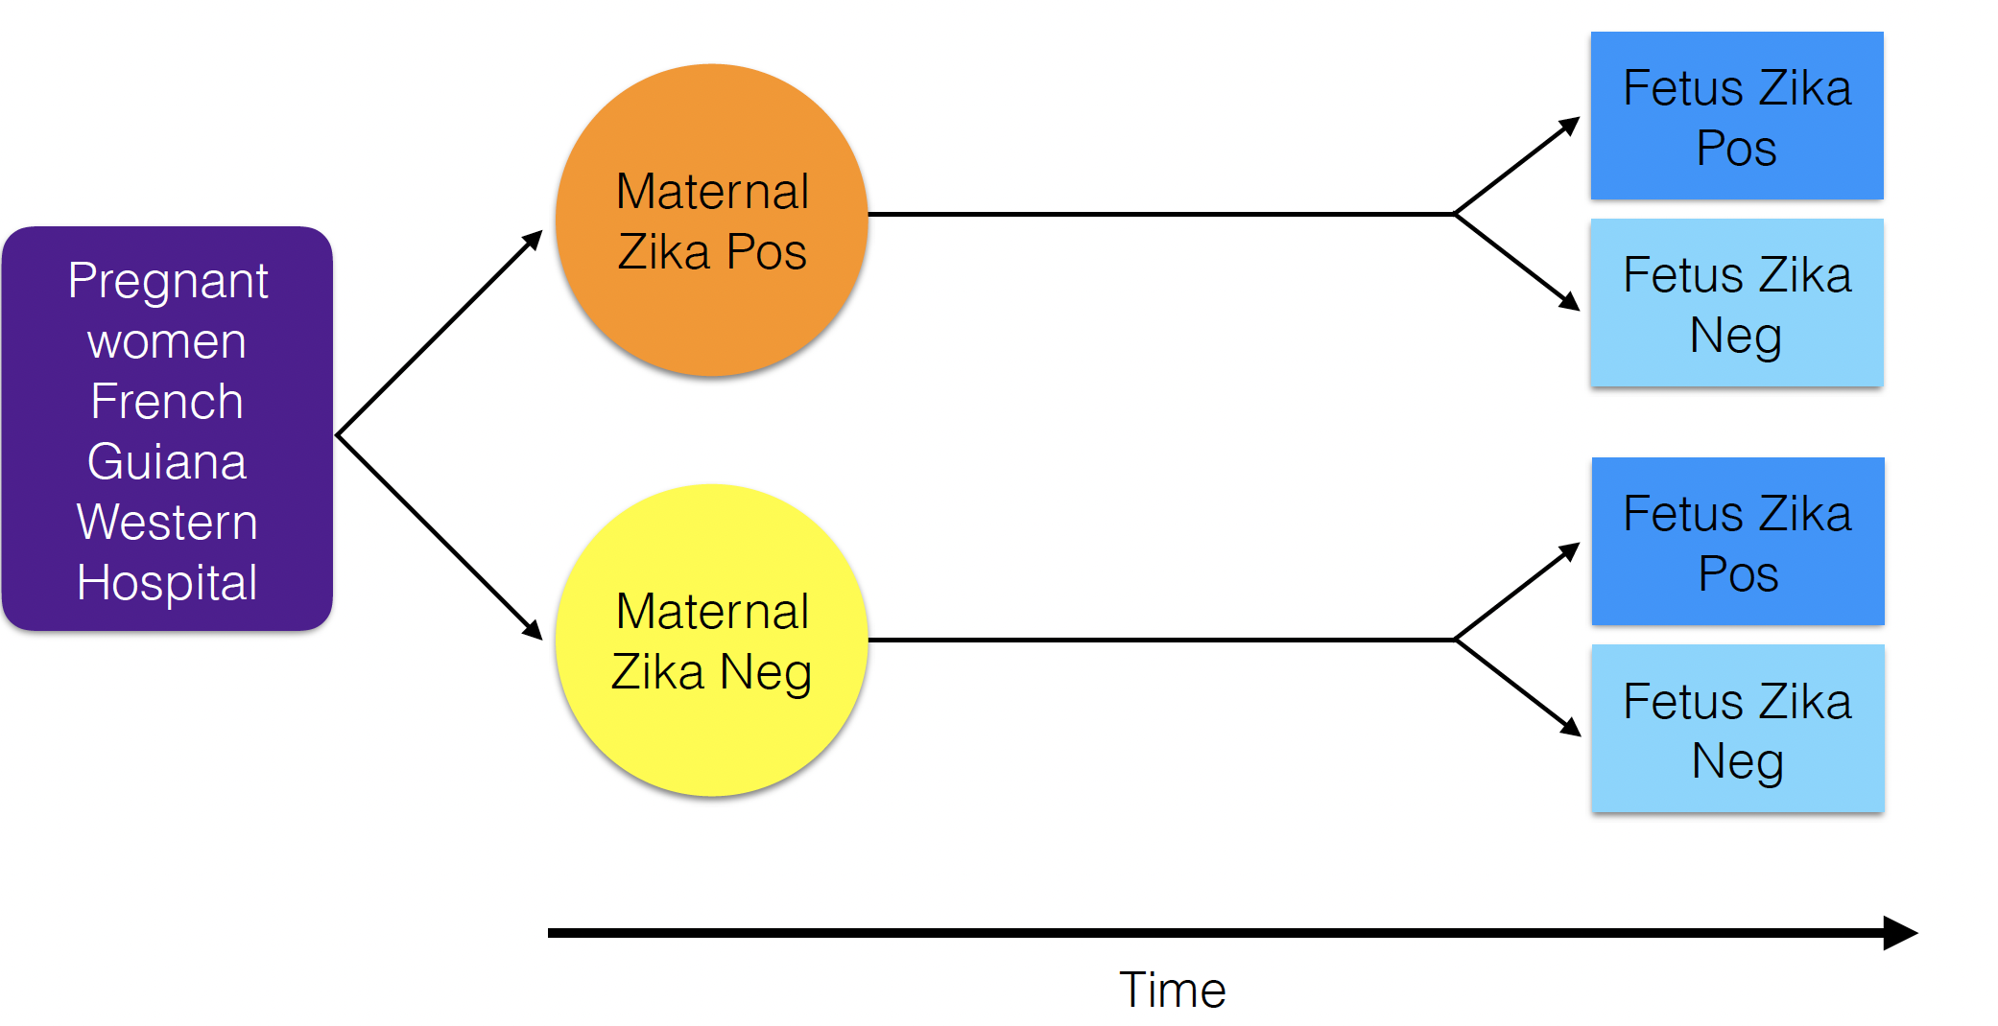
Cohort Study

Slide 41
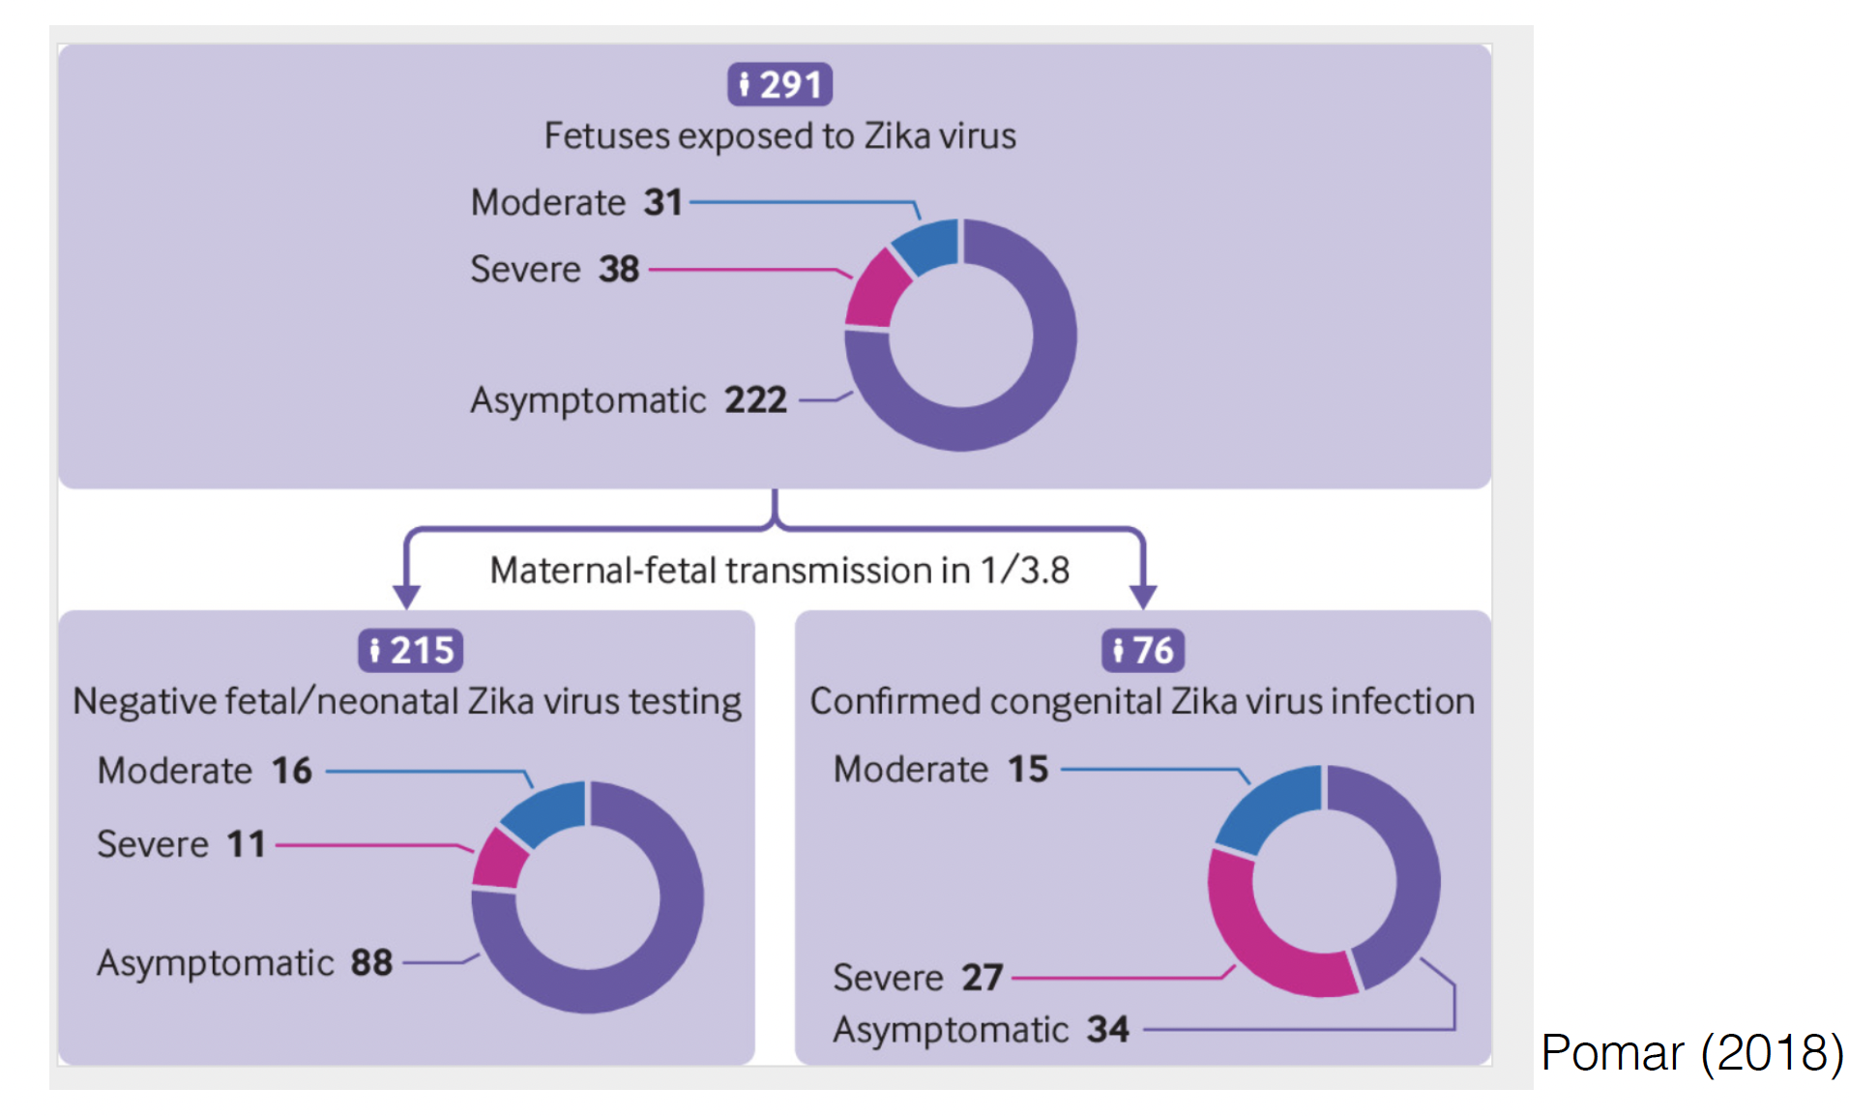
Cohort Study

Slide 42
Randomized Controlled Trial
Experiment in which subjects are randomly allocated into groups (test and control that are comparable) to receive or not to receive a preventative or a therapeutic procedure or intervention.
Results are assessed by comparison of rates of disease, death, recovery, or other outcome in the study groups.
Generally thought of as the most rigorous method of hypothesis testing.
Randomization should be blinded!

Slide 43
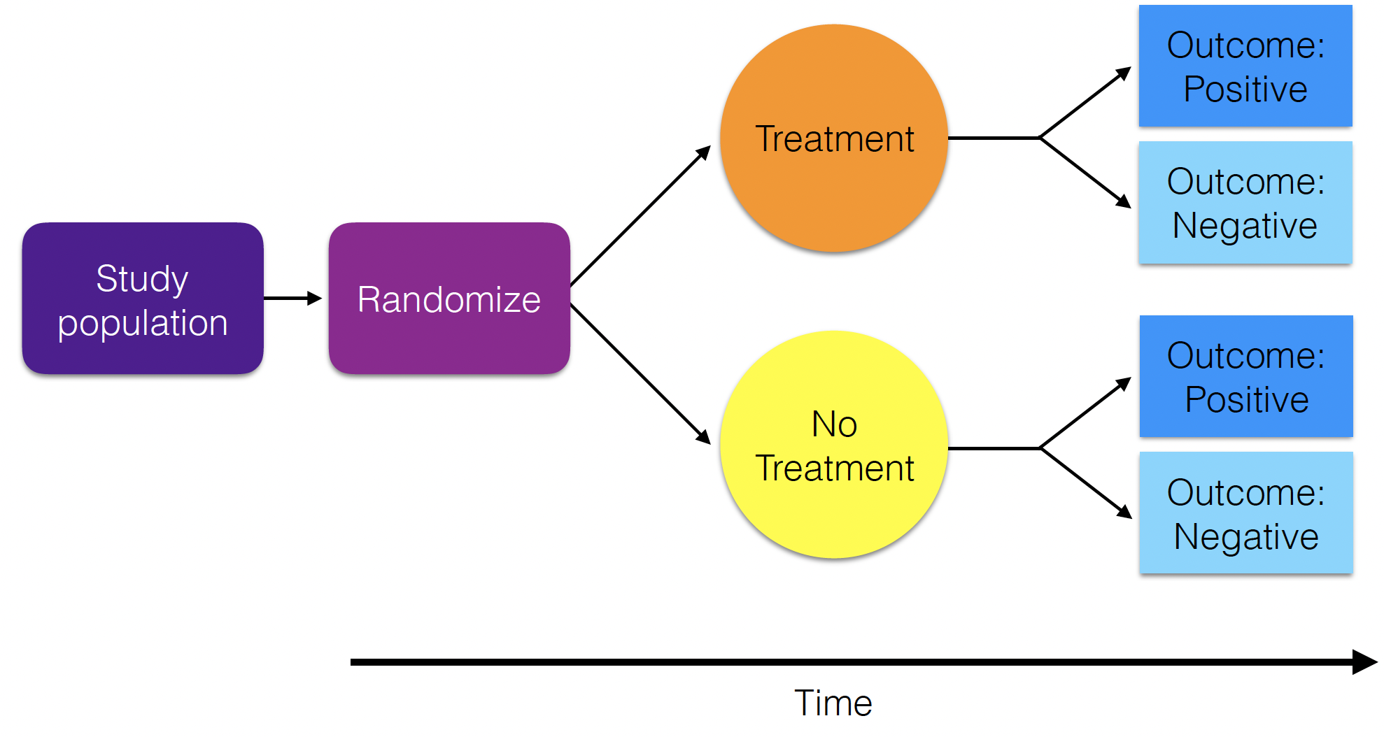
Randomized Controlled Trial

Slide 44
Randomized Controlled Trial
What is the effectiveness of a Zika containing vaccine?

Slide 45
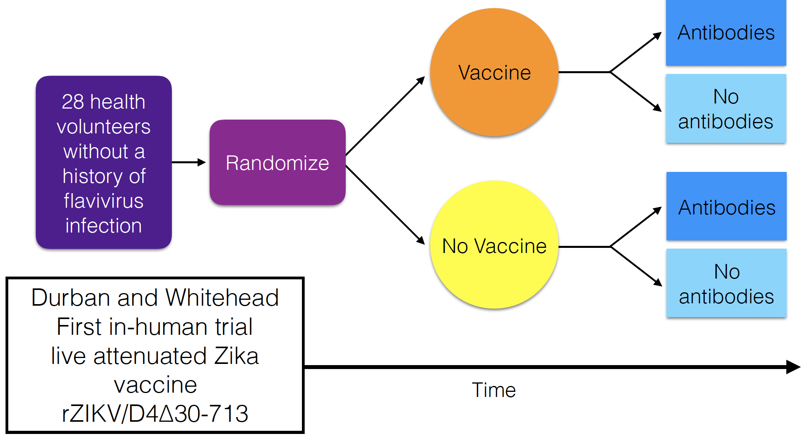
Randomized Controlled Trial

Slide 46
Different Study Types in Epidemiology

Slide 47
Different Study Types in Epidemiology
In epidemiology, ‘ecological study’ refers to a study used to understand the relationship between outcome and exposure at a population level, where 'population' represents a group of individuals with a shared characteristic such as geography, ethnicity, socio-economic status of employment.
Ex: What is the correlation between prevalence of TB and country-level GDP?

Slide 48
Ecological Study (Sampling) Design
Transects
Plots
Points

Slide 49
Ecological Study (Sampling) Design
Transects
Often with randomized site selection.
Sometimes nested
Site A, B, C
Each with plot 1, 2, 3
Or, sometimes in a paired design.
3 x pairs of (a) degraded vs. (b) pristine sites
Replication is key!
Plots
Points

Slide 50
Ecological Study (Sampling) Design
Transects
Often with randomized site selection.
Sometimes nested
Site A, B, C
Each with plot 1, 2, 3
Or, sometimes in a paired design.
3 x pairs of (a) degraded vs. (b) pristine sites
Replication is key!
Plots
Points

Slide 51
Ecological Study (Sampling) Design
Transects
Often with randomized site selection.
Sometimes nested
Site A, B, C
Each with plot 1, 2, 3
Or, sometimes in a paired design.
3 x pairs of (a) degraded vs. (b) pristine sites
Replication is key!
Plots
Points

Slide 52
Ecological Study (Sampling) Design
Transects
Often with randomized site selection.
Sometimes nested
Site A, B, C
Each with plot 1, 2, 3
Or, sometimes in a paired design.
3 x pairs of (a) degraded vs. (b) pristine sites
Replication is key!
Plots
Points

Slide 53
Ecological Study (Sampling) Design
Transects
Transects
Plots
Plots
Points
Points
Often with randomized site selection.
Sometimes nested.
Sometimes paired.
Replication is key!
Ecological manipulation

Slide 54
Ecological Study (Sampling) Design
Transects
Transects
Plots
Plots
Points
Points
Often with randomized site selection.
Sometimes nested.
Sometimes paired.
Replication is key!
Ecological manipulation
The most appropriate sampling design will depend on your study system and research question. You should simulate data before carrying out your study to test your analytical approach.

Slide 55
Power Analysis for Statistical Inference

Slide 56
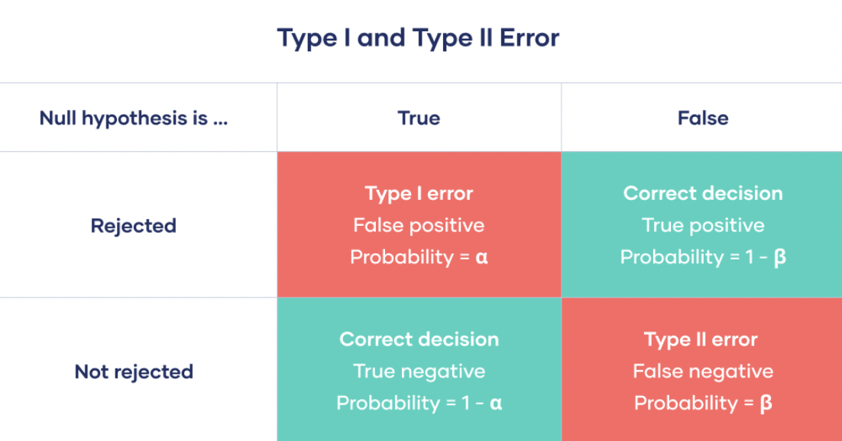
Power Analysis for Statistical Inference

Slide 57
Power Analysis for Statistical Inference

Slide 58
Power Analysis for Statistical Inference

Slide 59
Power Analysis for Statistical Inference

Slide 60
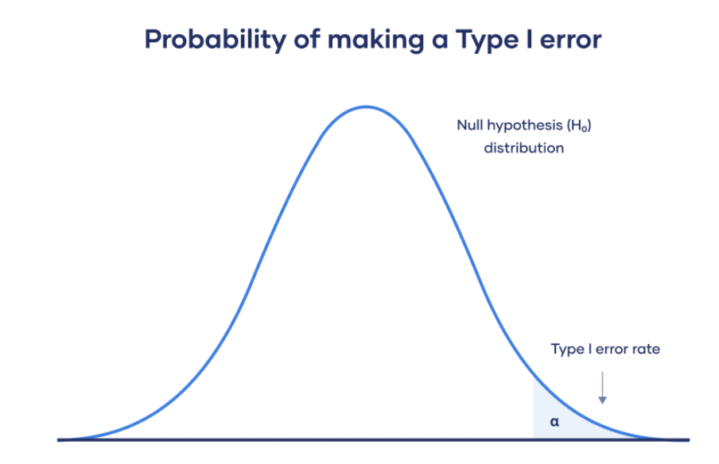
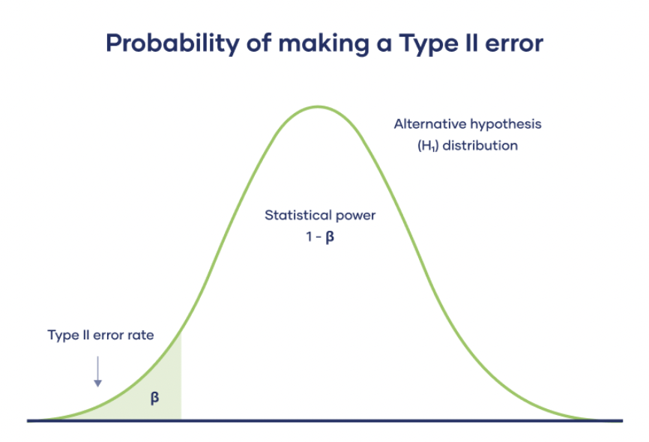
Power Analysis for
Statistical Inference
Type I error =false positive
rejecting the null hypothesis when it’s actually true.
the test result says you have coronavirus, but you actually don’t.
Type II error = false negative
failing to conclude there was an effect when there actually was
the test result says you don’t have coronavirus, but you actually do.

Slide 61
Power Analysis for
Statistical Inference
Type I error =false positive
rejecting the null hypothesis when it’s actually true.
the test result says you have coronavirus, but you actually don’t.
Type II error = false negative
failing to conclude there was an effect when there actually was
the test result says you don’t have coronavirus, but you actually do.

Slide 62
Power Analysis for Statistical Inference
Power analysis investigates the probability of detecting
an effect if it is actually there.
Type I error =false positive
rejecting the null hypothesis when it’s actually true.
the test result says you have coronavirus, but you actually don’t.
Type II error = false negative
failing to conclude there was an effect when there actually was
the test result says you don’t have coronavirus, but you actually do.

Slide 63
Power Analysis in R
Program ‘pwr’ for statistical models
Simulation and evaluation for mechanistic models

Slide 64
Simulation and evaluation for mechanistic models
age-seroprevalence data for E. dupreanum Nipah virus
Brook et al. 2019 J of Animal Ecology

Slide 65
Simulation and evaluation for mechanistic models
fitted model to age-seroprevalence data for E. dupreanum Nipah virus
Fit could be better in late age classes….
Brook et al. 2019 J of Animal Ecology

Slide 66
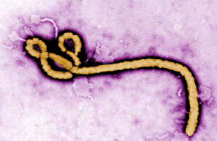
Simulation and evaluation for mechanistic models
Hyp 1: Lifelong Immunity
deaths
deaths
deaths
deaths
Ab
waning
trans-
mission
deaths
M
S
recovery
Ab
waning
births
I
R
N
T-cells

Slide 67
Simulation and evaluation for mechanistic models
Hyp 1: Lifelong Immunity
deaths
deaths
deaths
deaths
Ab
waning
trans-
mission
deaths
M
S
recovery
Ab
waning
births
I
R
N
T-cells
Hyp 2: Waning Immunity
deaths
deaths
deaths
deaths
Ab
waning
trans-
mission
deaths
M
S
recovery
Ab
waning
births
I
R
N
waning immunity

Slide 68
Simulation and evaluation for mechanistic models
fitted model to age-seroprevalence data for E. dupreanum Nipah virus
We need more field data to evaluate fit!
Fit could be better in late age classes….
Brook et al. 2019 J of Animal Ecology

Slide 69
Simulation and evaluation for mechanistic models
fitted model to age-seroprevalence data for E. dupreanum Nipah virus
We need more field data to evaluate fit!
Simulation can help us evaluate how much more.
Fit could be better in late age classes….
Brook et al. 2019 J of Animal Ecology

Slide 70
Simulation and evaluation for mechanistic models
simulated data at full population size

Slide 71
Simulation and evaluation for mechanistic models
simulated data after sub-sampling to 1000 bats

Slide 72
Simulation and evaluation for mechanistic models
simulated data after sub-sampling to 1000 bats
Would this plot look the same if we sub-sampled a second time?

Slide 73
Simulation and evaluation for mechanistic models
fitted lifelong immunity model (hyp1) to data subsample
AIC = 1277

Slide 74
Simulation and evaluation for mechanistic models
fitted lifelong immunity model (hyp1) to data subsample
AIC = 1277
What would change if we sub-sampled more data?

Slide 75
Simulation and evaluation for mechanistic models
fitted waning immunity model (hyp2) to data subsample
AIC = 1291

